Slide 1


Container Monitoring System

Slide 2
IoT Sensors
Position and deviation of the route
Temperature
Humidity
Concentration of Gases

Slide 3
Optional IoT Sensors
Vibrations
Impacts
Proximity
Door opening and seal integrity
Weight

Slide 4
Communications technologies for 6loWPAN networks
Wi-SUN
Wi-SUN (Wireless Smart Ubiquitous Network) is a wireless communication technology designed for Utilities, Smart Cities and IoT. Wi-SUN is based
on various IEEE, IETF, and ANSI/TIA standards supporting low power and lossy networks.
Wi-SUN is an established suite of IoT technologies that is based on IEEE 802.15.4, TCP/IP, and related standard protocols.
Important characteristics of Wi-SUN include the following:
Coverage: Range measured in kilometers.
Development Ecosystem: Wi-SUN Alliance with task groups for targeted use cases and assured interoperability
High Bandwidth: Up to 300 kbps.
Low Latency: 0.02 seconds
Mesh Routing: Resilient and scalable
Power Efficiency: less than 2 uA when resting; 8 mA when listening
Scalability: Networks to 5,000 devices; 10 million endpoints worldwide
Security: Public key certificates, AES, HMAC, dynamic key refresh, hardened crypto

Slide 5
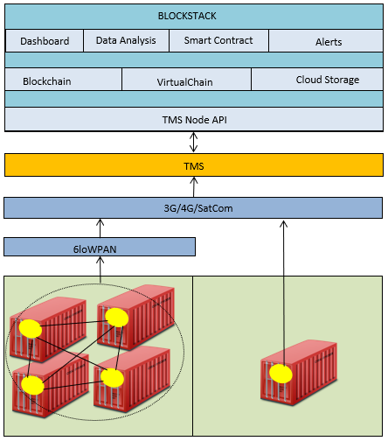
General System Architecture

Slide 6
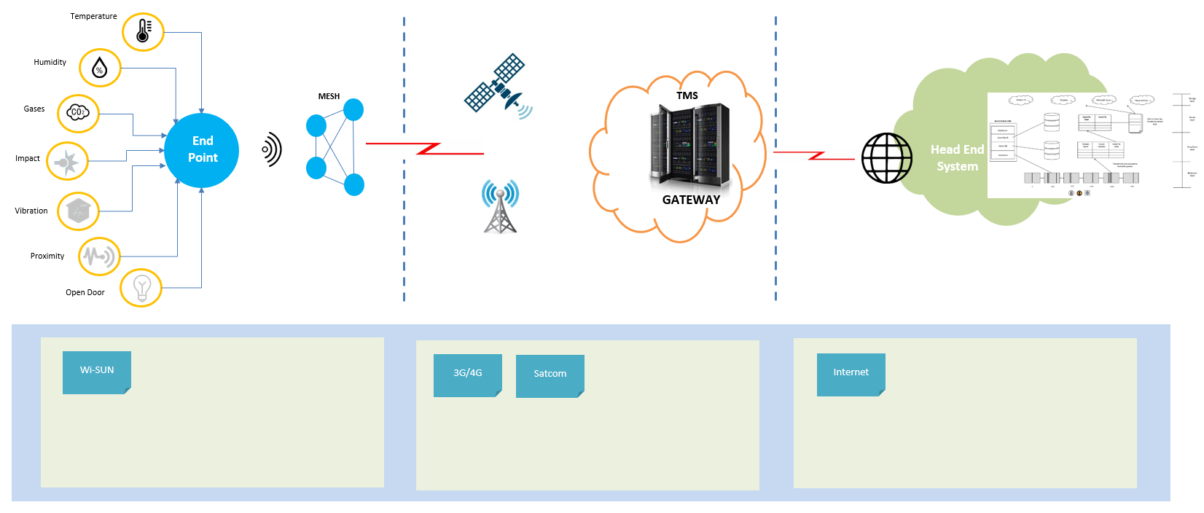
General System Architecture

Slide 7
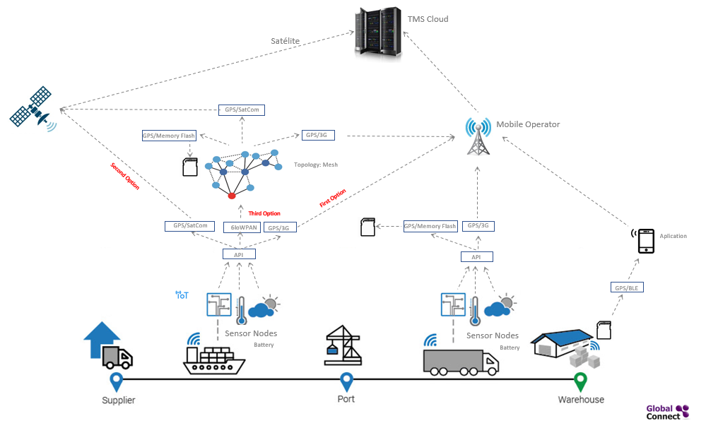
General System Architecture

Slide 8
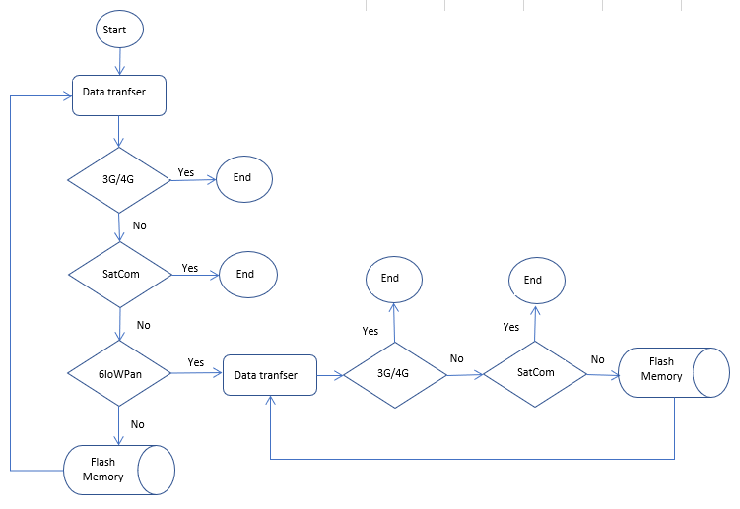
General System Architecture

Slide 9
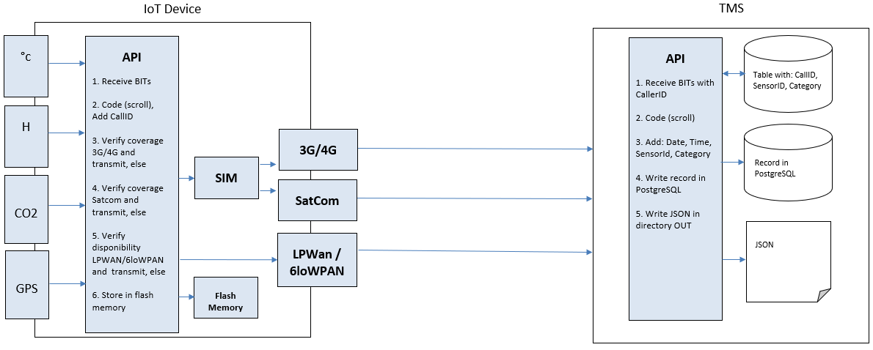
The IoT devices and the Gateway TMS central station

Slide 10
Example Event with JSON
{
"data": [
{
"DTEvent": "2018-10-21T12:34:00:7992",
"EventsContainer": [
{
"CallID": "9835676546",
"EventsSensor": [
{
"ContainerSensorId": 4019,
"ContainerCategorySensorId": 34,
"Value": "1",
"PositionsGPS": {
"coordinates": [
-0.308595436,
39.43556368
]
"type": Point
},
"DTregistry": "2018-10-21T10:30:44:00Z",
},
{
"ContainerSensorId": 4020,
"ContainerCategorySensorId": 34,
"Value": "14",
"PositionsGPS": {
"coordinates": [
-0.308595436,
39.43556368
]
"type": Point
},
"DTregistry": "2018-10-21T10:33:59:00Z",
}
]
}
]
}
]
}

Slide 11
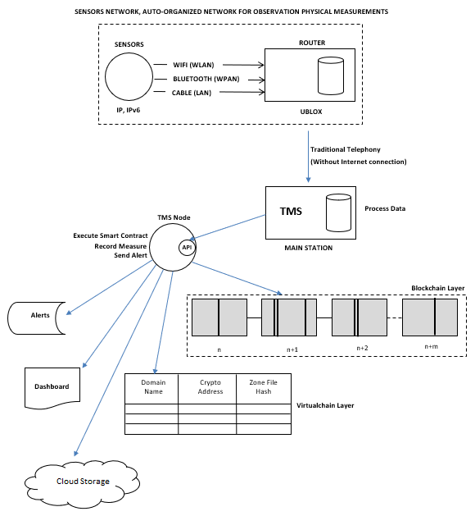
Gateway TMS central station and the TMS Node API

Slide 12
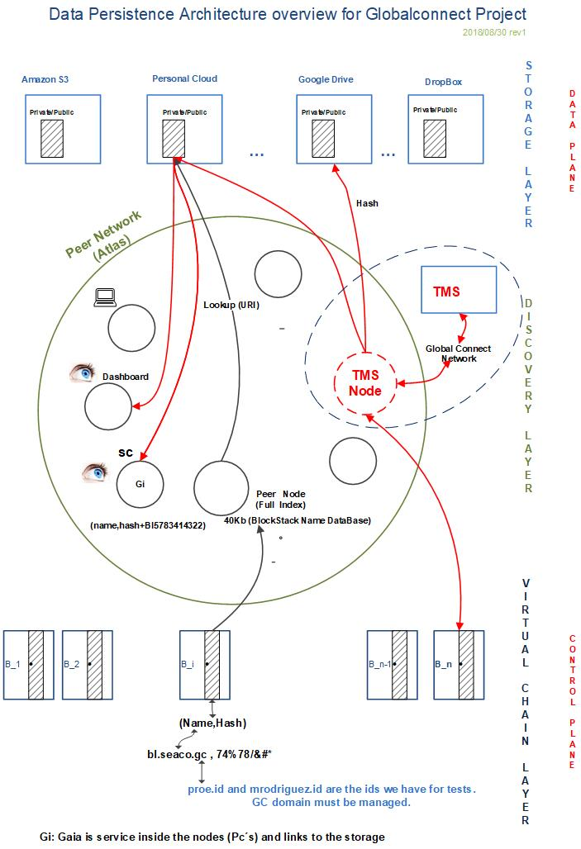
Blockchain with Blockstack

Slide 13
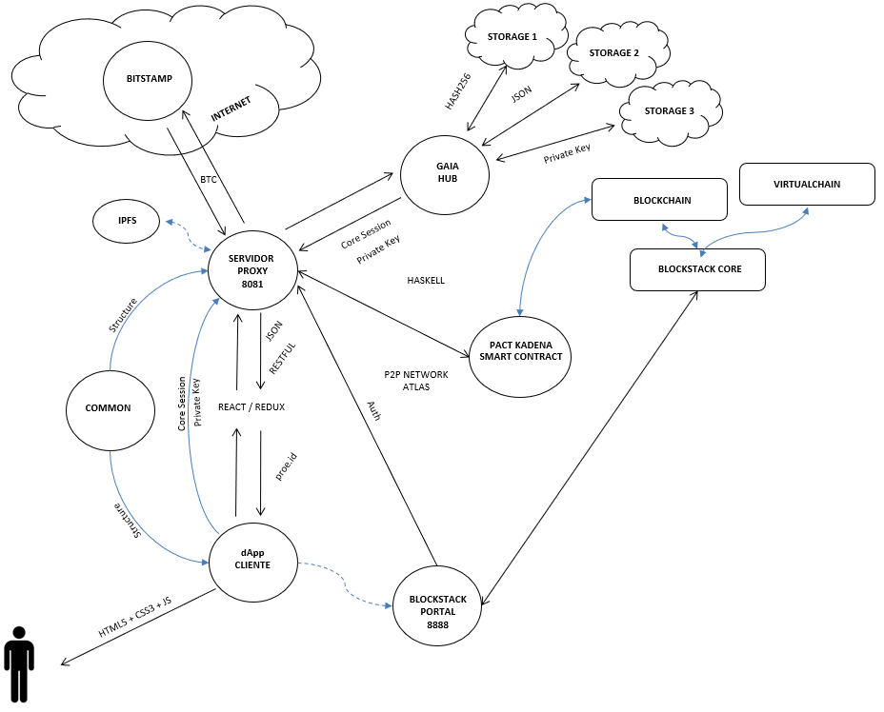
Blockchain with Blockstack

Slide 14
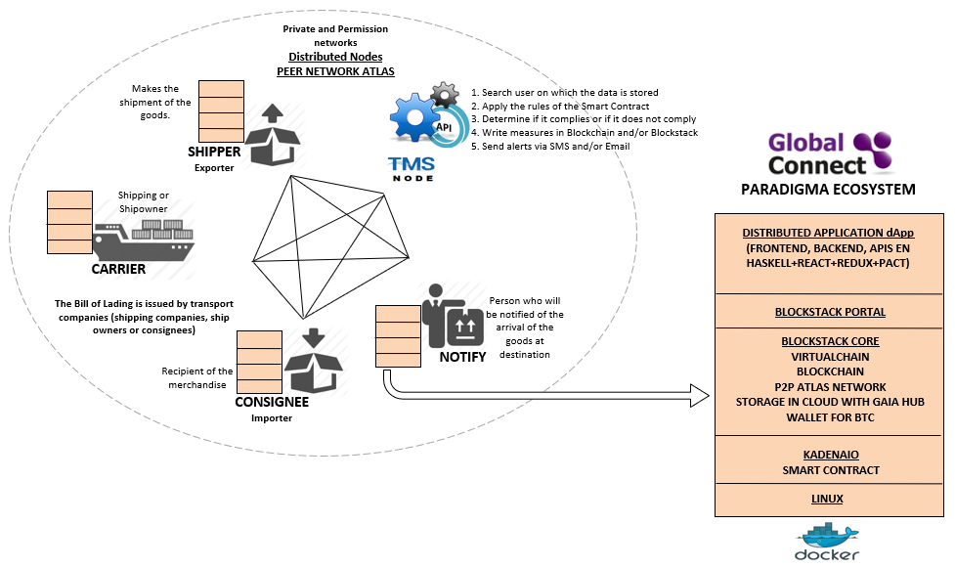
dApp

Slide 15
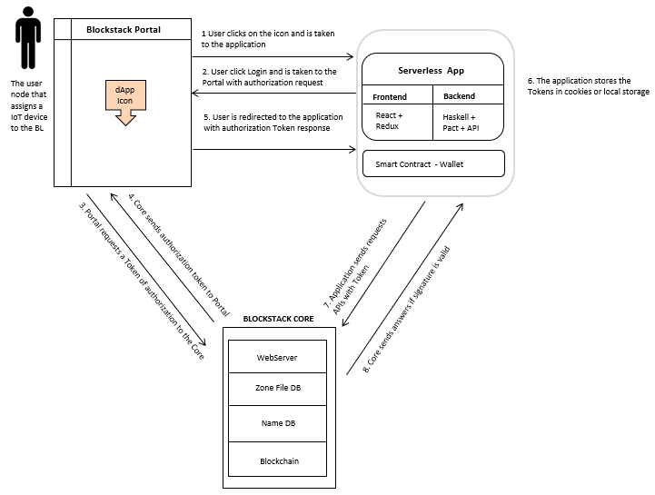
dApp

Slide 16
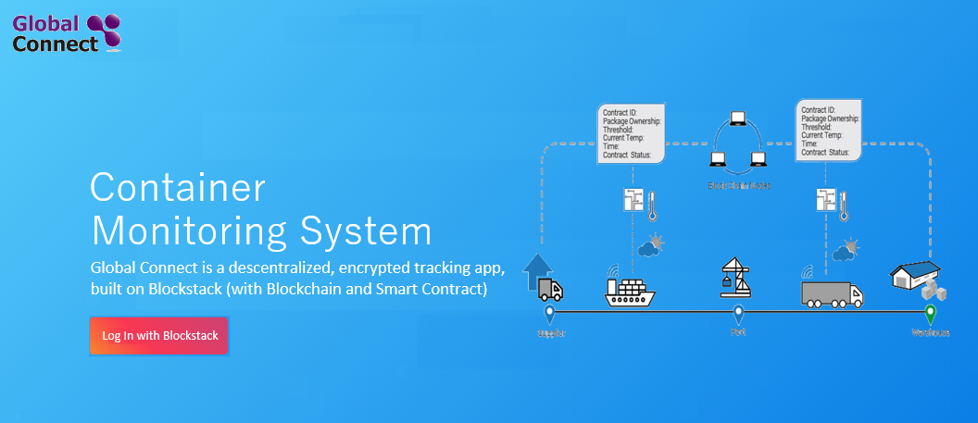
Dashboard

Slide 17
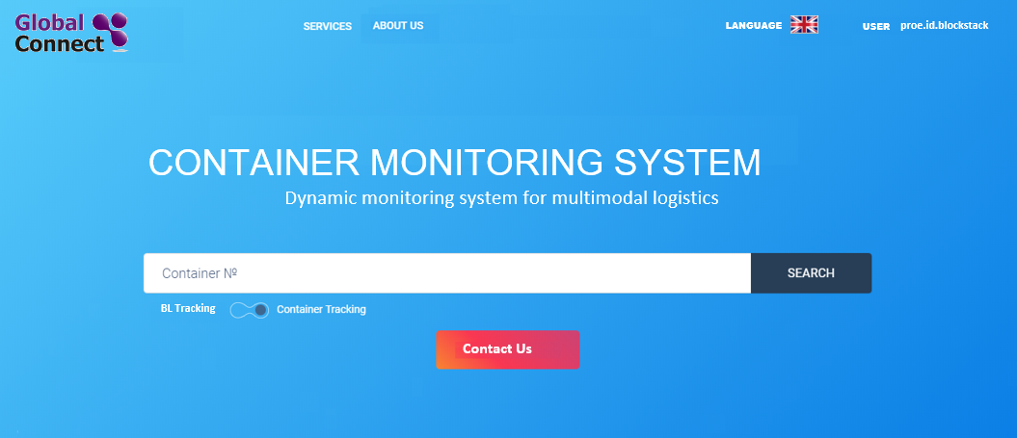
Dashboard

Slide 18
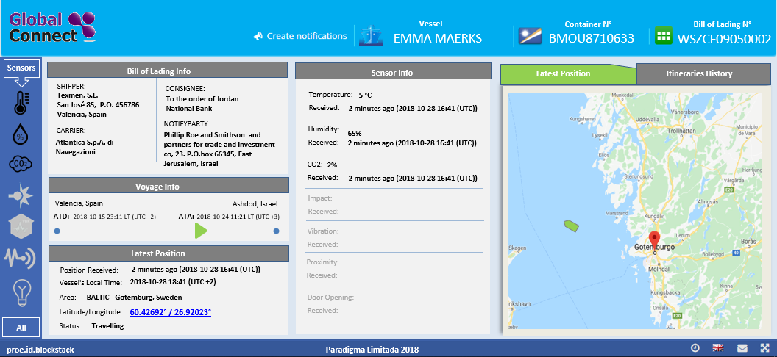
Dashboard

Slide 19
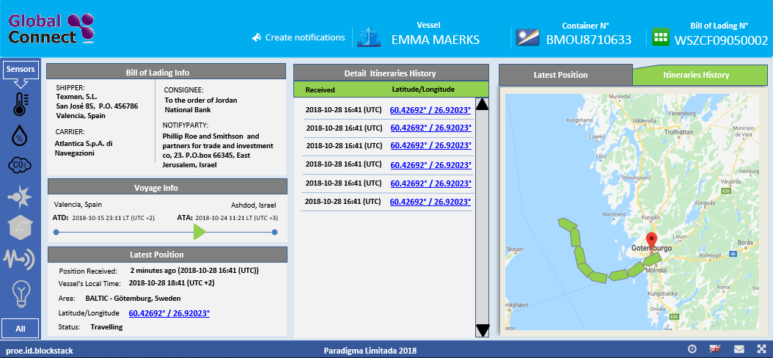
Dashboard

Slide 20
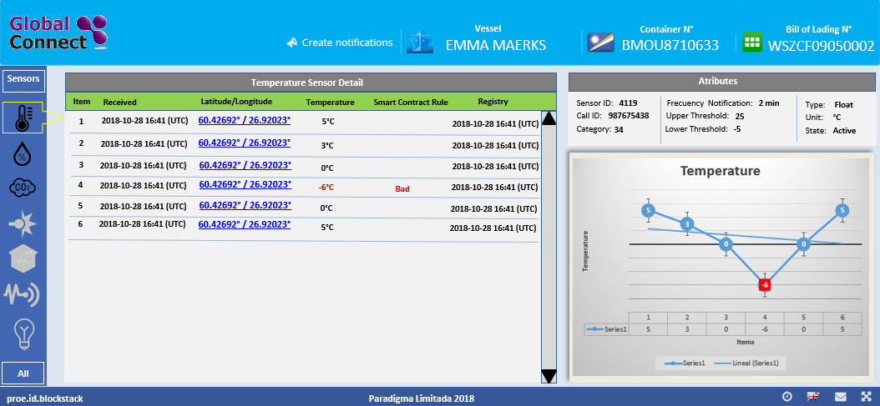
Dashboard

Slide 21
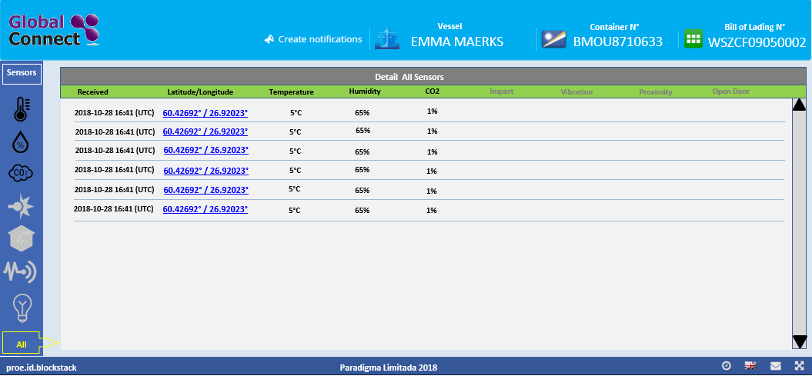
Dashboard

Slide 22
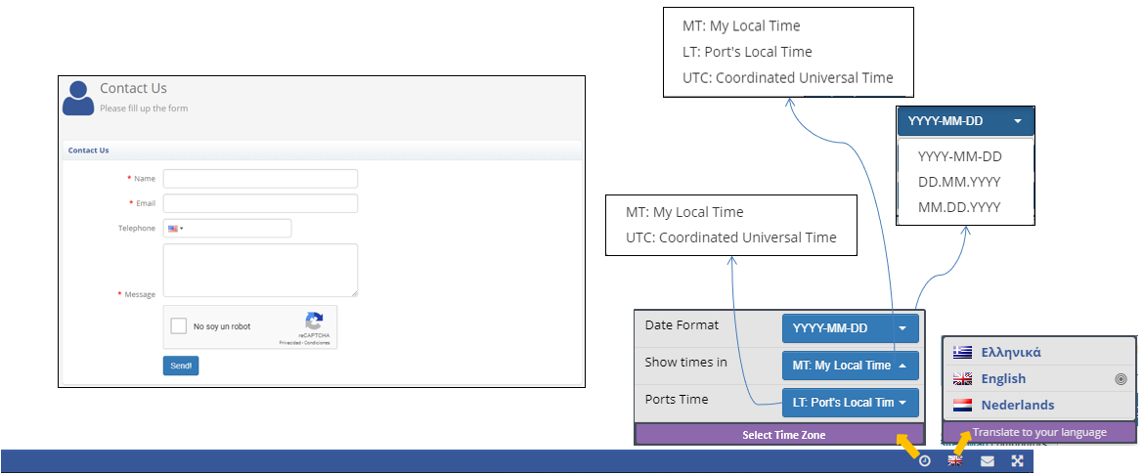
Dashboard

